Slide 1
How to set up a school makerspace
Roxanne Summer
Head of Educational Resources
summer@bialik.vic.edu.au
Notes:
Good afternoon, my name is Roxanne Ciddor. I run the library and eLearning departments at Bialik College, a kinder to year 12 private school in Melbourne.

Slide 2
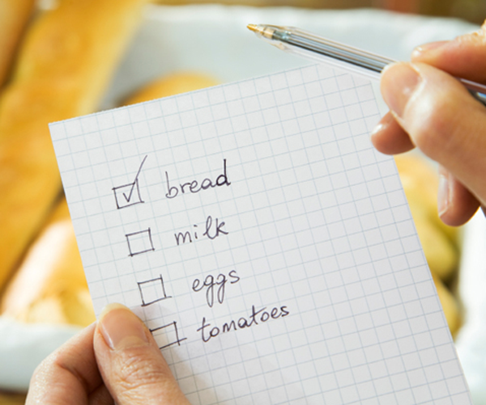
Introduction
Focus on the “how” not the “what”
Notes:
If you are expecting a comprehensive shopping list and step-by-step guide, you are about to be disappointed.
In this presentation I will
delve briefly into the definition and history of the maker movement,
Give tips for how to move from co-curricular to curricular engagement
and advice for how to generate buy-in from management, teachers, students and parents.
We will also look at how to incorporate Harvard’s Cultures of Thinking into your makerspace.

Slide 3
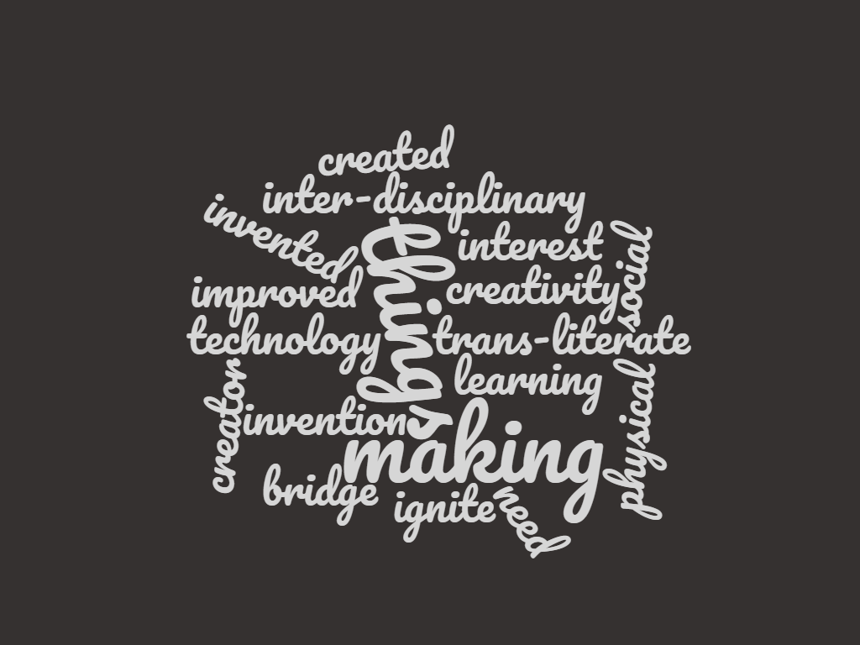
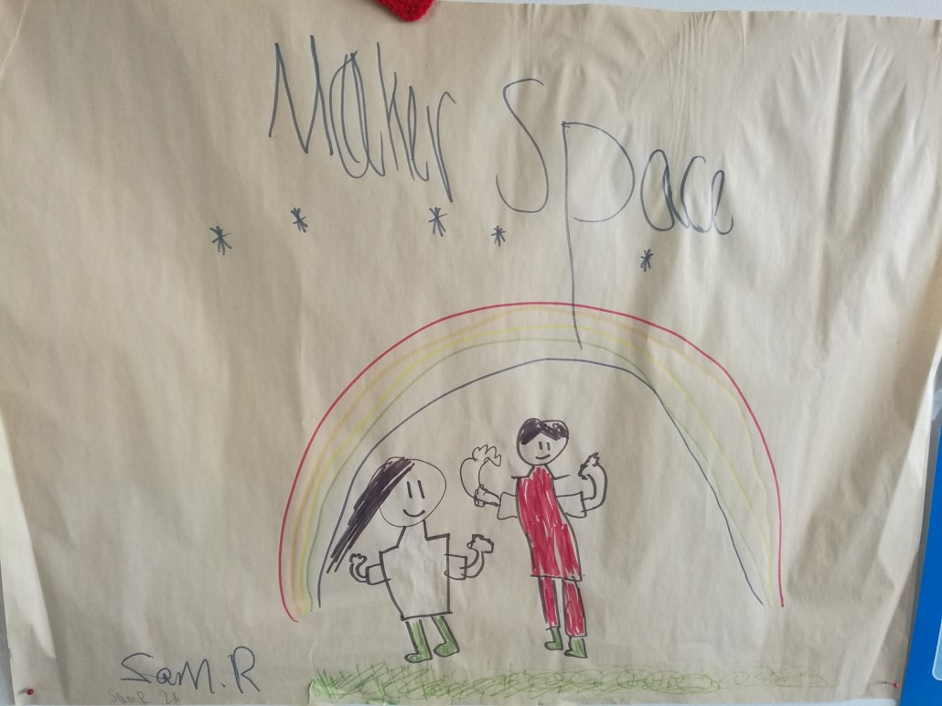
Definition
Notes:
There are many definitions but essentially, a makerspace is:
a space that facilitates creativity, invention and making
a space that is focused on the intersection of technology with physical making
a space that aims to ignite an interest in how things work, how things can be improved and what things need to be created or invented – a place to bridge the creator vs. consumer gap
Makerspaces were born in libraries and, like libraries, have always been a space for shared social learning that is inter-disciplinary and trans-literate.

Slide 4
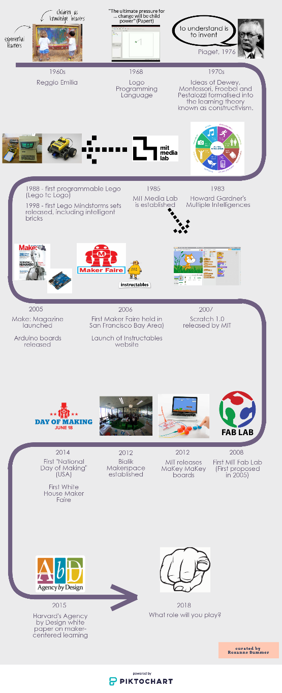
Origins of the Maker Movement
Notes:
To look at a brief history of the maker movement -
1960s and 1970s -> founding pedagogy and learning theory

Slide 5
Origins of the Maker Movement
Notes:
1980s – founding technology and attitude shift towards the potential role of technology in education

Slide 6
Origins of the Maker Movement
Notes:
2000s – founding organisations providing support and resources

Slide 7
Origins of the Maker Movement
Notes:
2010s – political and communal recognition

Slide 8
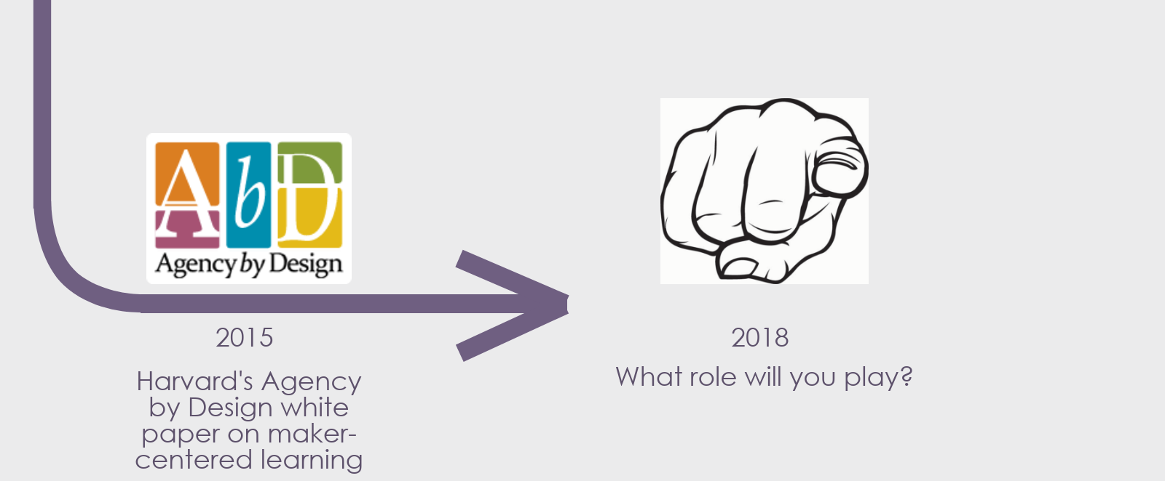
Origins of the Maker Movement
Notes:
Today – academic support and you.
What role will you play in this global movement?

Slide 9
From co-curricular to curricular
Be an opportunist
Notes:
How do you move your makerspace from co-curricular to curricular engagement?
Be an opportunist, don’t wait for an invitation –
Keep your ear to the ground at all times
e.g. Kinder art? -> combine with sound and create interactive art using Makey Makey
e.g. Science week? -> turn the staircase into a piano for the week
There is a clear obligation to fulfil the Digital Technologies Curriculum and Design and Technologies Curriculum within the Australian Curriculum
It is easier to justify expenditure when resources are used by multiple disciplines
Money spent on makerspace where programs run within the curriculum is money spent on the curriculum

Slide 10
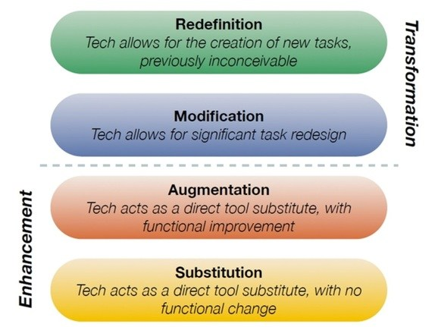
From co-curricular to curricular
Transformation not change
SAMR Model
Notes:
Make sure makerspace and making is not presented as a polemic against traditional educational structures - one is not at the expense of the other
Making transforms traditional units and doesn't threaten to change the content of the curriculum
The SAMR model best illustrates the role of technology to transform education
e.g. Dioramas with 360 camera -> view in VR headset

Slide 11
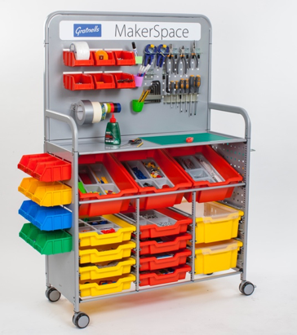
From co-curricular to curricular
Makerspace as a concept
Notes:
Makerspace is a concept, a theory, a way of learning, a set of dispositions and not just a space or its contents.
As such, it can be brought into any classroom or space.
Physically, a makerspace can be a dedicated space, a series of spaces or even mobile (or a combination of all 3)
e.g. our ELC makerspace will be a series of themed trolleys, designed to go into classrooms rather than take kids out of them
Flexibility breeds opportunity

Slide 12
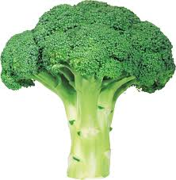
Generating buy-in
Repetition,
repetition,
repetition
Notes:
How do you generate buy-in from administration, teachers, students and parents?
Be a part of everything
Continually present making and your makerspace is as many contexts and in as many ways as possible
Just like broccoli, you need to present it in many ways, on different days until the understanding of “what’s good for you” grows

Slide 13
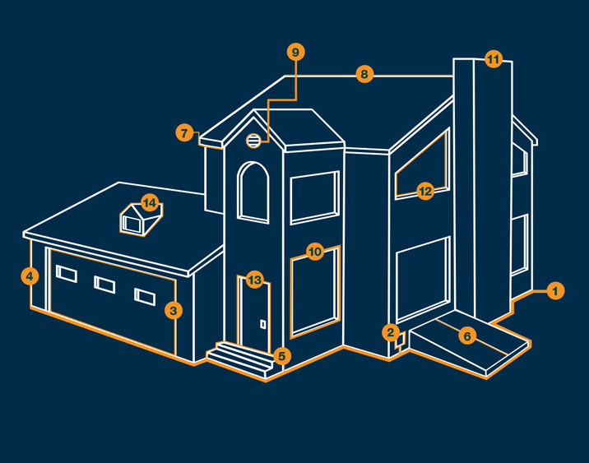
Generating buy-in
Multiple points of entry
Notes:
Buy-in comes from using multiple Points of Entry – can use them all and in combination
- Project-based (e.g. today we’re making slime)
- Free Play
- Skills-based/workshop: "How To"
- Problem-solving or community based
- Competition
- Exhibition or demonstration
- Expert ("Maker-in-residence")

Slide 14
Generating buy-in
Power of information
Notes:
Sign-in, tracking -> statistics
Membership process
Clear links to 21st Century skills and dispositions being sought by employers – this is especially important to parents
Link to research

Slide 15
Generating buy-in
Makerspace is a mindset
Notes:
Makerspaces start with a mindset - this is free and can be taken from class to class with ease.
A slow build up of equipment and materials is a positive thing and can be better than a big spend. If you buy it slowly, you have exactly what you want and are responsive to students' needs.
Emphasis on recycled and reused materials over expensive and specialised equipment – This approach is more accessible to parents and staff than technical terms. Reused and repurposed materials also inspire creativity and innovation.
Grow the mindset first, the resources are secondary.

Slide 16
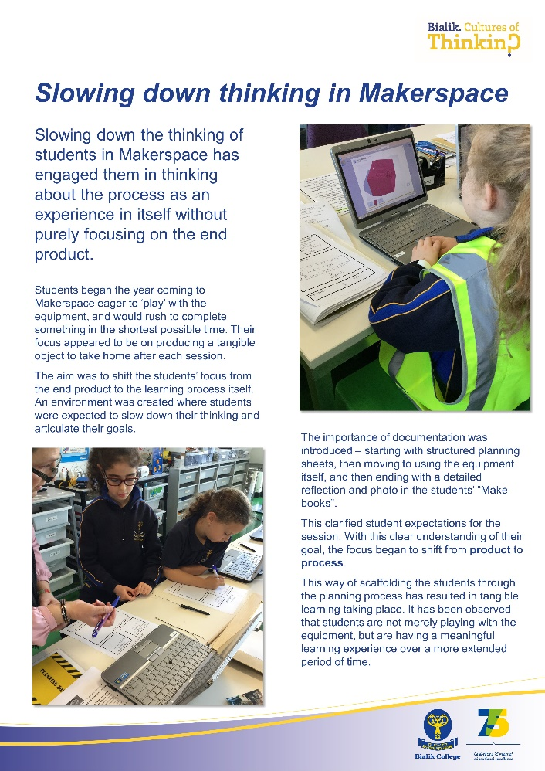
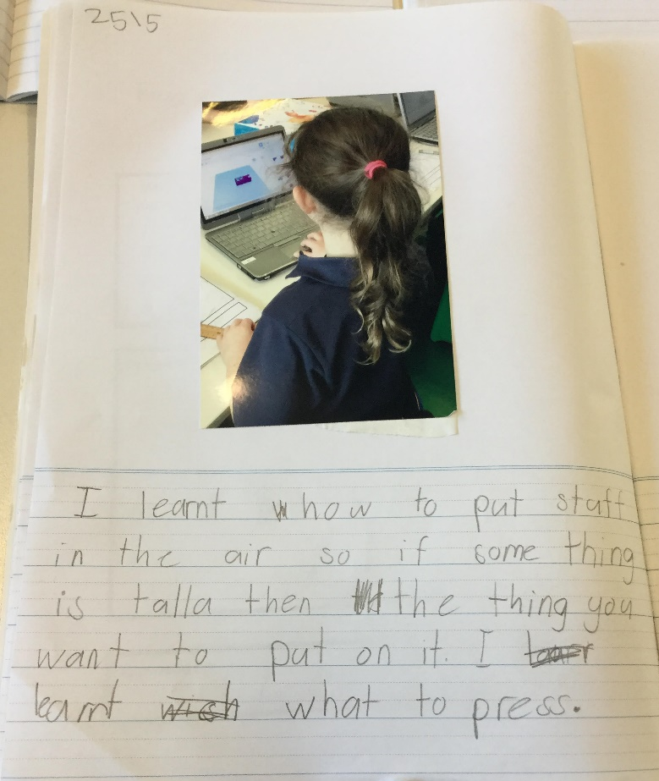
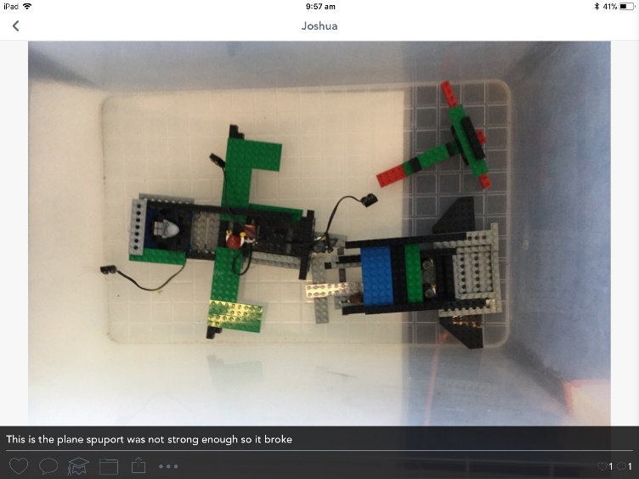
Incorporating CoT
Documentation
Notes:
There are several ways we incorporate Harvard’s cultures of thinking philosophies into our makerspace
Make books
Sentence starters
Need for photo/visual
Digital documentation (SeeSaw)
Greater audience
More accessible as you can record voice and video, as well as text and stills
Allows for more agency as students can include more detail, more steps along the process
Professional documentation – for parents, students and teachers to see
Shifts emphasis from product to process

Slide 17
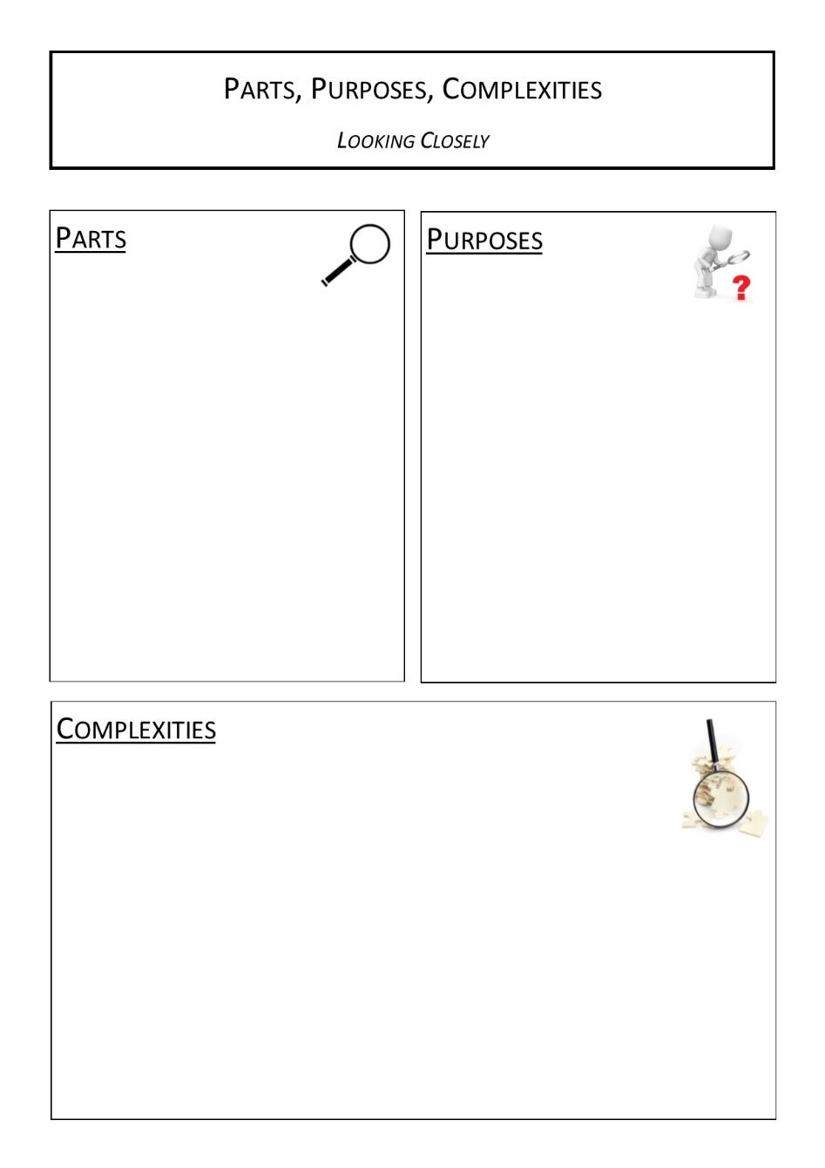
Incorporating CoT
Methodology & Observation
Notes:
Along with documentation, thinking routines are used to develop thinking skills and habits:
e.g. Deconstruction - purpose, parts, complexities
Some thinking routines have been developed specifically for the makerspace context.
Stop and listen, ask questions – write it down and reflect as a team
Notice and name – focus on disposition over product

Slide 18
Notes:
Thank you – If you would like the link to a related resource list I have posted on my website, please see me during the next break.

